Slide 1
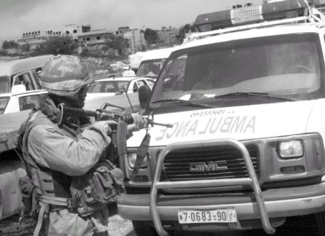
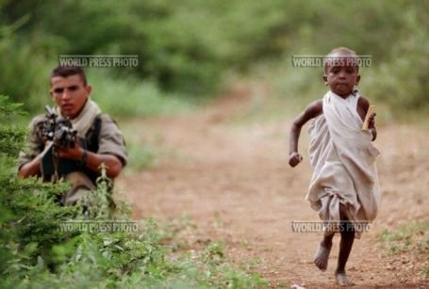
Armed conflict and its effects on the health of babies and young children
The International Health Protection Initiative IHPI
http://ihpi.org
Dr Rhona MacDonald and Professor David Southall
Maternal and Childhealth Advocacy International

Slide 2
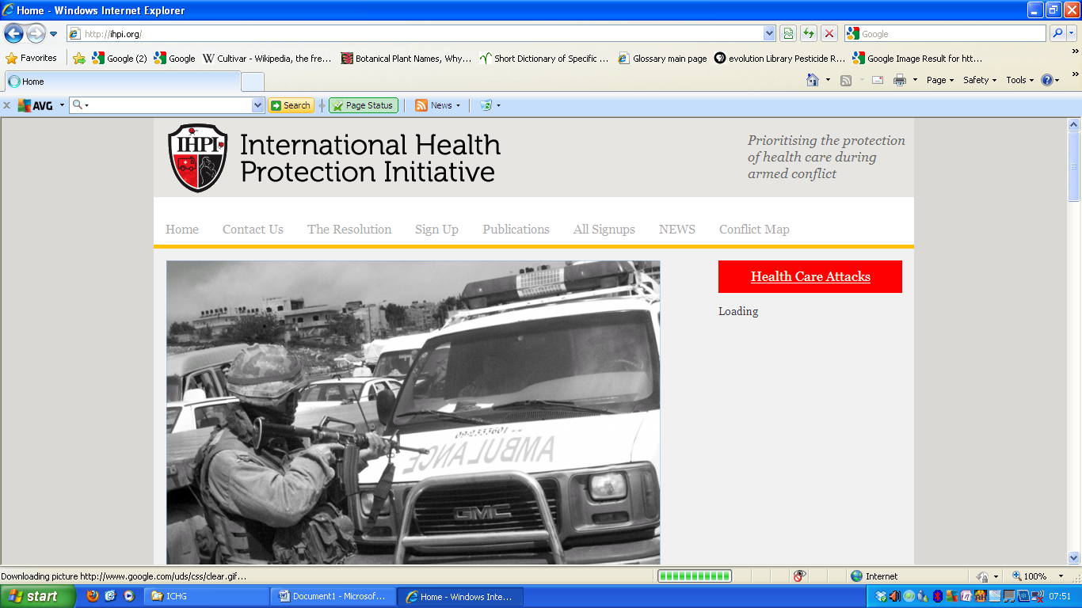
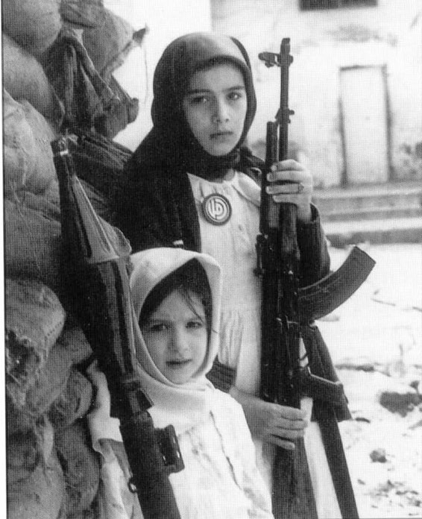
http://ihpi.org

Slide 3
Main health consequences of conflict
Not just for the child his/herself but also through effects on his/her mother and family:
Death and permanent injuries: physical, sexual and psychological
Deliberate impedance of health workers and damage to health facilities by armed factions
Malnutrition
Lack of immunization
Water and sanitation destruction and spread of infections such as cholera

Slide 4
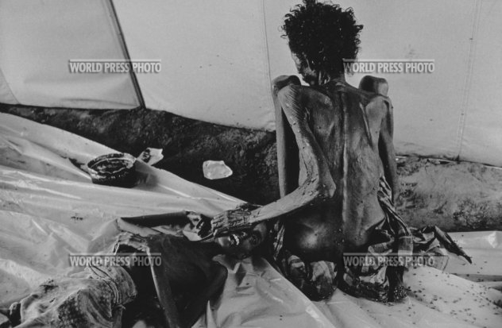
Security is a prerequisite for health
“The nexus of security, insecurity and health must take centre stage in foreign policy thinking”
Dr Robin Coupland ICRC 2007
In a tent reserved for the very sick, an emaciated woman touches the dead body of a member of her family. Somalia 1992
NOTHING CHANGES

Slide 5
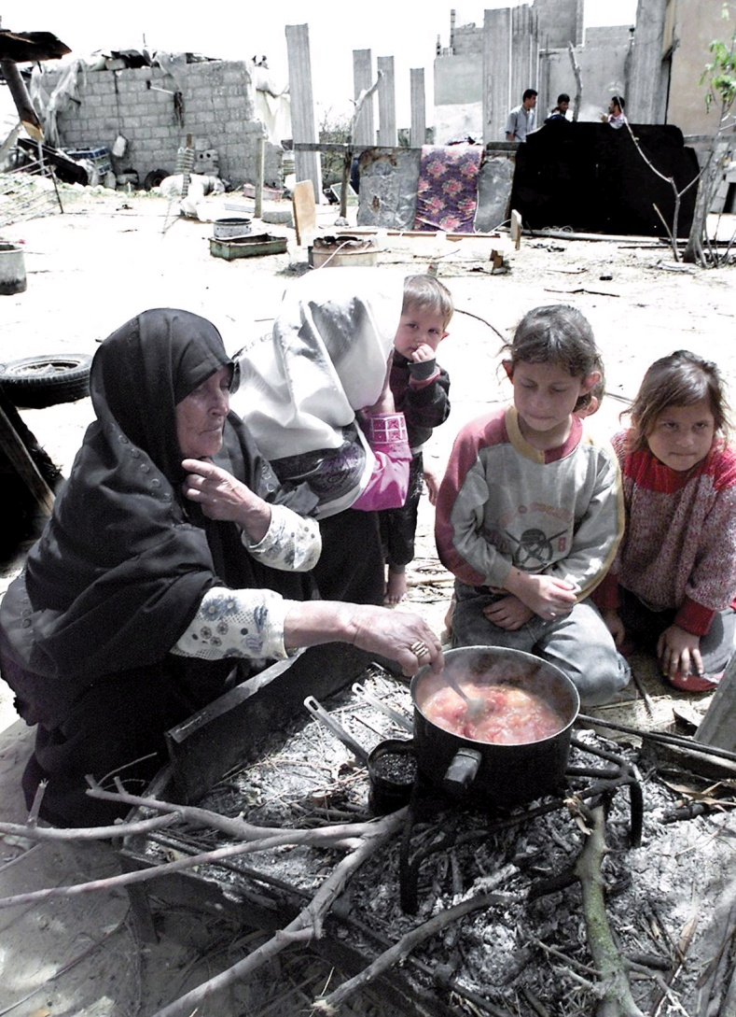
The reality: Geneva Conventions and other International Humanitarian Laws
Some governments and their armies (for example Sri Lanka in 2009) and some armed groups (influenced by religious extremism, alcohol or drugs) are unwilling to be concerned about or adhere to international laws or conventions.

Slide 6
No Protection
“UN forces have held the line in the Democratic Republic of Congo, with bravery under the difficult circumstances. Yet we have not been able to protect innocent people from violence”
UN Secretary General, Ban Ki-moon
December 2008

Slide 7
Background IHPI Resolution
Following 2010 meeting of the International Child Health Group, organized by IHPI,
two organizations aiming to protect healthcare were established 1. The Safeguarding Health in Conflict Coalition and 2. the Healthcare in Danger project of ICRC
Both have continued to identify the magnitude of attacks on healthcare but, despite their efforts to stop these, the situation globally is worsening

Slide 8
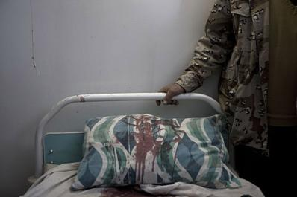
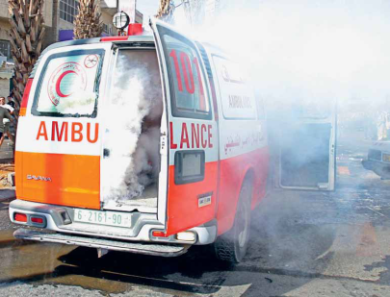
ICRC August 2011 Healthcare in danger
16 country study
655 violent incidents
33% by state armed forces, 37% by armed groups, 7% by police, 17% by others
23% explosive weapons, 34% firearms, 4% other weapons

Slide 9
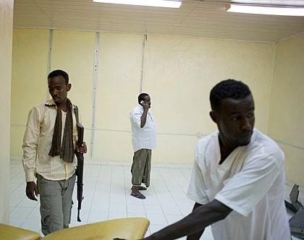
ICRC Violence against health workers 655 events involving 2374 people
733 killed and 1101 injured (patients and health workers-national and international)
166 kidnapped (health workers)
111 denied access and 18 removed from healthcare
188 threatened
93 arrested
35 robbed
Somali doctor under guard

Slide 10
3rd May 2016 UN Security Council enacted Resolution 2286 supported by 80 UN States
“Urges States to take steps to prevent attacks on health facilities and health workers, reform their domestic laws to strengthen protection, train their militaries and security forces in the requirements of international law, collect data on attacks, investigate violations that take place, and hold perpetrators accountable”

Slide 11
Safeguarding Health in Conflict Coalition 3/5/17
Documented in 2016 attacks on healthcare in 23 countries in an article entitled “Impunity Must End”
1. The bombing, shelling, and looting of hospitals and clinics
2. The killing of health workers, emergency medical personnel, and patients
3. The intimidation, assault, arrest, and abduction of health workers and patients
4. The obstruction of access to care including blockage of and attacks on ambulances
5. The takeover and occupation of health facilities by police, military, or other armed actors and attacks on and blockage of humanitarian actors, supplies, and their transport.

Slide 12
Within 3 months of UN Resolution 2286
An aid convoy was attacked in Syria on the 20th September 2016 and the UN failed to take action
In Syria alone, six hospitals were attacked in Aleppo Governorate at the end of July 2016, the highest number experienced in a single week since the war began
MSF reported 19 of its facilities in Syria attacked since Resolution 2286
Hospitals and health workers in Yemen, Afghanistan, and elsewhere, were also attacked in the 3months following the resolution

Slide 13
Questions raised in 2012 Healthcare in Danger symposium at BMA
1. "The proliferation of arms, most originating from the permanent members of the UN Security Council, is without doubt adding to the ferocity and inhumanity of existing conflicts and their effects on defenseless citizens; damaging their health and healthcare. Should we not be targeting the unethical trade in arms and inputting to the Arms Control Treaty under discussion at this time.”
2. "Given that in every recent conflict the Geneva Conventions have been blatantly disregarded with impunity, isn't it time to discuss the option of establishing and implementing an international protection system which has the mandate, authority and power to protect the health and healthcare of defenseless citizens who are being deliberately targeted and attacked? And if so what form should such an international protection system take?”
3. "Surely respect for the sovereignty of States has to be based on the responsibility of the behavior of those in power".

Slide 14
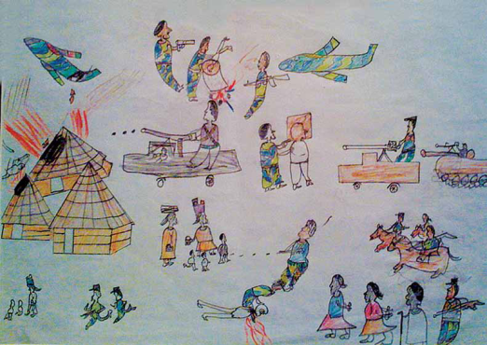
“A culture of protection”
"As human beings, we cannot be
neutral, or at least have no right
to be, when other human beings
are suffering. Each of us...must
do what he or she can to help
those in need, even though it
would be much safer and more
comfortable to do nothing"
UN Secretary General Kofi Annan in 2001
Drawing by a child in Darfur

Slide 15
The experiences of the last 7 years, demonstrate that the UN Security Council is not able to implement protection.
IHPI continues to advocate for a specially formed global health protection system, funded and established within the UN but independent of the veto accorded to the permanent members of the UN Security Council.

Slide 16
Veto on substantive decisions by UNSC permanent members must be ended
Why?
Because they have major conflicts of interest when voting
All 5 are the global leaders in the sale of major weapons and small arms
Because, unlike most countries in 2017 where armed conflict is present, the permanent members are rich and have good maternal and child health indicators

Slide 17
UN Security Council (UNSC): arms trading and maternal and child health indicators
Country Permanent members UNSC | Small arms and light weapons global transfers in millions USD in 2015 NISAT 2017 | Major weapons global rank of trading position In 2011-15 SIPRI 2016 | Major weapons sold In 2014 billions USD SIPRI 2016 | Maternal mortality ratio /100,000 live births in 2015 UNICEF | Under 5 deaths / 1000 live births In 2015 UNICEF | Neonatal deaths /1000 live births in 2015 UNICEF | GNI /capita USD in 2015 UNICEF
China | 50 | 3 | No accurate data | 27 | 11 | 6 | 7,400
France | 145 | 4 | 22.6 | 8 | 4 | 2 | 42,960
Russian Federation | 1,505 | 2 | 40.8 | 25 | 10 | 5 | 13,220
United Kingdom | 146 | 6 | 41.8 | 9 | 4 | 2 | 43,430
USA | 5,028 | 1 | 218.0 | 14 | 7 | 4 | 55,200

Slide 18
UN Security Council (UNSC): arms trading and maternal and child health indicators
10 Countries with most lethal armed conflicts. May 2017 | Small arms and light weapons global transfers in millions USD in 2015 NISAT 2017 | Major weapons global rank of trading position In 2011-15 SIPRI 2016 | Major weapons sold In 2014 billions USD SIPRI 2016 | Maternal mortality ratio /100,000 live births in 2015 UNICEF | Under 5 deaths / 1000 live births In 2015 UNICEF | Neonatal deaths /1000 live births in 2015 UNICEF | GNI /capita USD in 2015 UNICEF
Afghanistan | - | - | - | 396 | 91 | 36 | 680
Iraq | - | - | - | 50 | 32 | 18 | 6,500
Mexico | 42 | - | - | 38 | 13 | 7 | 9,870
Nigeria | - | - | - | 814 | 109 | 34 | 2,970
Somalia | - | - | - | 732 | 137 | 40 | <1
South Sudan | - | - | - | 789 | 93 | 39 | 970
Sudan | - | 48 | - | 311 | 70 | 30 | 1,710
Syria Arab Republic | - | - | - | 20 | 13 | 7 | 1 to 4
Turkey | 240 | 16 | 2.0 | 16 | 14 | 7 | 10,830
Yemen | - | - | - | 385 | 42 | 22 | 1,300

Slide 19
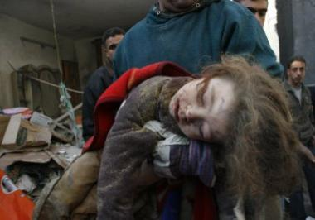
But if veto cannot be ended?
A specially formed global health protection system, funded and established within the UN but independent of the veto accorded to the permanent members of the UN Security Council should be established

Slide 20
Proposed UN system to enforce health protection in areas of conflict
protection for health facilities, hospitals and clinics
protection for the delivery of essential drugs, medical equipment and supplies.
protection for health workers from attack and intimidation during their work, in their homes, and to and from their places of work.
protection to ensure safe transport of ill or injured patients to and from health facilities

Slide 21
Proposed UN system to enforce health protection in areas of conflict
5. ensure that the protection system is appropriately mandated and equipped
6. ensure protection for incoming UN agencies and NGOs providing healthcare
7. ensure health care is protected from abuse by armed factions storing weapons in hospitals, launching attacks from healthcare facilities ,or the transporting members of armed forces in ambulances (other than those who are seriously injured)

Slide 22
Advocacy for a new International Health Protection System
Armed persons attacking the health of civilians are committing war crimes. Protection to ensure healthcare must not be denied
Just as doctors accept that the police are sometimes needed to enforce the protection of women or children who are being abused, so the international community should consider whether a similar system is required to protect civilians from those who are defying Geneva conventions and International Humanitarian Laws

Slide 23
How could a new health protection system work?
1. Accept that neutrality is not appropriate; the abusers of health are the problem and must be stopped
2. Identify a current armed conflict for a first attempt at implementation (a pilot project)
3. Involve the ICC in giving formal agreement to act and prevent further war crimes
4. Have a UNSC resolution to support actions to be taken, if possible
5. Ensure that as many members as possible of the protection system are going to act in an ethical manner (perhaps an excess of women?)
7. Aim for arrest and prosecution for war-crimes rather than death/injury of perpetrators

Slide 24
How could a new health protection system work?
8. Combine with protected humanitarian assistance for health
9. Work with government, unless they are responsible for the war crimes
10. Avoid other agendas (political or financial)
11. Have an exit strategy
12. Publicise as a deterrent

Slide 25
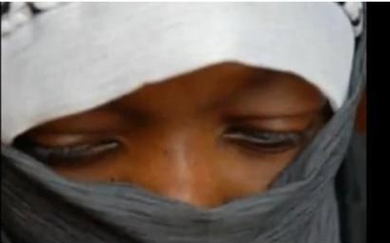
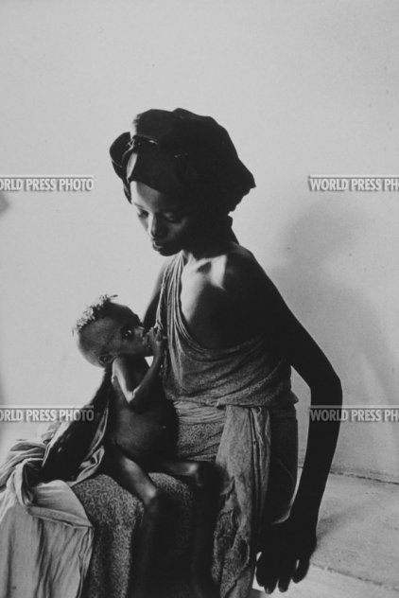
Conclusions
All professionals concerned
with maternal, infant and child healthcare to lobby for the development of an adequate international protection system for health in countries affected by armed conflict
A pilot protection programme
in one conflict zone where
positive results should be achievable

Slide 26
Protection of civilians during armed conflict
The primary responsibility for the protection of civilians rests with the Governments of countries
In the Millennium Declaration, UN Member States pledged to "expand and strengthen the protection of civilians in complex emergencies."

Slide 27
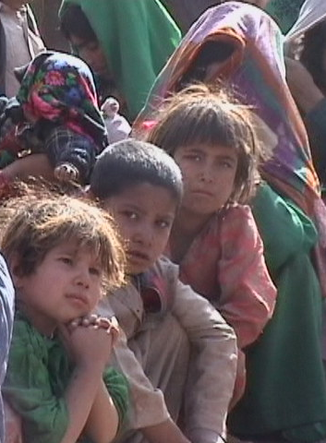
UNOCHA 2011
“Grave violations of international humanitarian and human rights law and blatant disrespect for the normative framework of humanity that has emerged over the past 50 years is common to many of these conflicts.
Civilians have become the primary target of attack motivated by ethnic or religious hatred, political confrontation or simply ruthless pursuit of economic interests”

Slide 28
Maternal mortality in 72 (37%) of countries where armed conflict 1990 -2010
38 (53%) maternal mortality ratios > 200/100,000 live births
with 21 > 500 and 4 > 1000/100,000 live births

Slide 29
Country | N under 5 deaths per yr/50 million population | N. Infant deaths/yr/50 million population | N. neonatal deaths/yr/50 million population | N. Maternal deaths/yr/50 million population
Countries where armed conflict 2010
Chad | 473,803 | 281,108 | 102,015 | 27,204
Afghanistan | 460,088 | 309,808 | 120,224 | 32,368
DRC | 441,581 | 279,594 | 115,388 | 14,867
Somalia | 396,180 | 239,909 | 114,452 | 26,412
CAR | 297,711 | 194,992 | 78,345 | 14,799
Countries exporting small arms and light weapons in 2009
USA | 5,608 | 4,907 | 2,804 | 168
Bulgaria | 4,830 | 3,864 | 2,415 | 63
UK | 3,648 | 3,040 | 1,824 | 73
Norway | 1,809 | 1,809 | 1,206 | 42
France | 2,388 | 1,791 | 1,194 | 47

Slide 30
Vulnerability of women and girls
Rape is used as a weapon of war
Women and girls are vulnerable to sexual violence, trafficking and mutilation, whether at home, in flight or in camps for displaced populations
The trauma for female victims of sexual violence continues even when the conflict is over, as they are frequently shunned, ostracized and further stigmatized

Slide 31
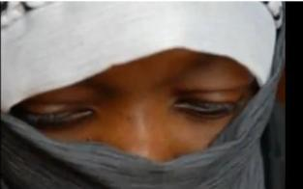
Vulnerability of women and girls
Less able to protect themselves from violence
Risk of serious infection, such as HIV and hepatitis
Possibility of pregnancy that may result in miscarriage and heavy blood loss which, in the absence of blood transfusion or basic surgery, can be life threatening.
High prevalence of septic abortion following self or non-professional attempts to end the pregnancy

Slide 32
Vulnerability of women and girls
In Darfur, Sudan a doctor witnessed militia “surrounding a girls' school and holding over 40 girls, as young as eight, and their teachers in a primary school, and, while the army stood guard, the militia repeatedly gang-raped the girls”.
A film accompanying this report describes how the fetuses of pregnant women were ripped out by armed gangs and the newborn girls raped before being killed

Slide 33
Vulnerability of women and girls UN Security Council 2000
First ever resolution on women and peace and security
Called for prosecution of crimes against women, for increased protection of women and girls during war, and for more women to participate in decision-making in conflict resolution and peace processes

Slide 34
(22nd November 2010) The Emergency Relief Coordinator for UNOCHA and Under Secretary General for Humanitarian Affairs at the UN, Baroness Amos
“The Secretary-General’s report paints a very bleak picture of the state of the protection of civilians. Any positive and encouraging developments are heavily outweighed by what is happening on the ground: the continuing and frequent failure of parties to conflict to observe their international legal obligations to protect civilians. Complementary to this is the failure of national authorities and the international community more broadly to ensure their accountability in any meaningful, comprehensive and systematic sense”

Slide 35
In a tent reserved for the very sick, an emaciated woman touches the dead body of a member of her family. Somalia 1992

Slide 36
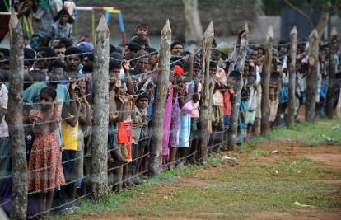
UN Security Council Resolution 1894 (2010)
Expressed deep regret over the toll on civilians involved in armed conflict, reaffirmed readiness to respond to to deliberate targeting and demanded strict compliance with international humanitarian, human rights and refugee law

Slide 37
Effects of violence against health workers
1996 ICRC hospital Chechnya 6 nurses killed by gunmen (hospital treating 2000 patients/ year closed)
2009 Graduation ceremony for medical students Mogadishu, bomb killed 2 doctors plus 18 others including unknown number of just qualified medical students

Slide 38
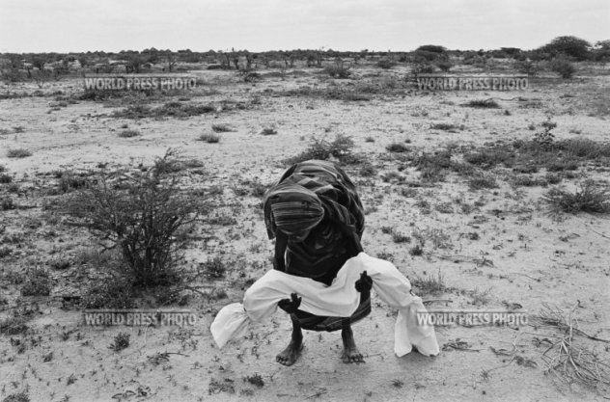
Somalia 2011
Absent healthcare and extreme malnutrition
Without protection, thousands have already died and many hundreds of thousands of will die imminently or be permanently damaged by the failure to protect health

Slide 39
War Crimes
Between 2003 and 2008, the Geneva conventions were violated in all armed conflicts examined
International criminal justice institutions have potential power, but do not operate in the time frame necessary to protect healthcare during conflict.
Rubenstein and Bittle Lancet 2010

Slide 40
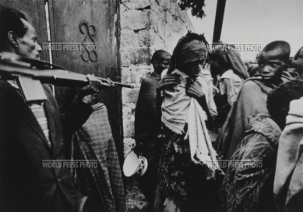
Health protection also means……
Safety from physical and
sexual abuse
Nutrition
Safe water and sanitation

